Slide 1
RevoU Case Study - eCommerce Analysis
BY : AJIMAS GALUNG CANDRA

Slide 2
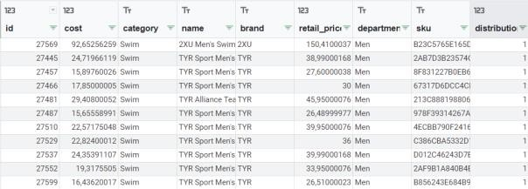
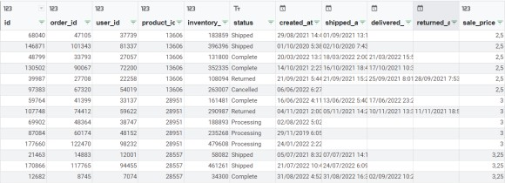
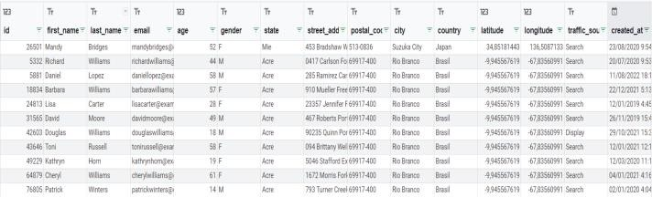
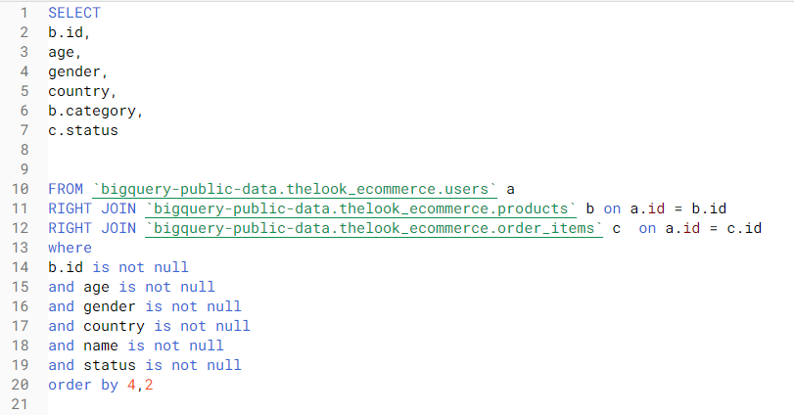
DATA ANALYTICS WITH SQL-TABLEAU
Background
Data analytics case study is part of mini course data analytics program held by RevoU. In this case study, the participant asked to create their own problem definition and solved it individually.
Problem Definition
Average e-commerce users age of male and female in 5 largest e-commerce user’s
countries.
Best-selling product category in the country's largest e-commerce user.
Purchase Status in 14 Countries on e-commerce percentage from 26 February
2022 to 26 August 2022.
Tools
MySQL and Tableau
Data Overview
Data used for this case study taken from bigquery public data, dataset name is
“thelook_e-commerce”. To answer problem, three table taken from dataset :
Methodology
1. Choose the data used from e-commerce public data that then export in CSV
format. This process done using SQL in Google BigQuerry.
R E V O U D A T A A N A L Y T I C S C A S E S T U D Y
Products table : The Look fictitious e-commerce dataset - products table. Products table contains product details such as category, brand, price, etc.
Users table : Programatically generated users for The Look fictitious e-commerce store. Users table contains e-commerce users data such as name, email, age, gender, country, address, etc.
Order_items table : Programatically generated order items for The Look fictitious
e-commerce store. Order_Items table contains order status data.
2. CSV from Google BigQuery then imported into Tableau to visualize the data and find the answer from problem definition.
4

Slide 3
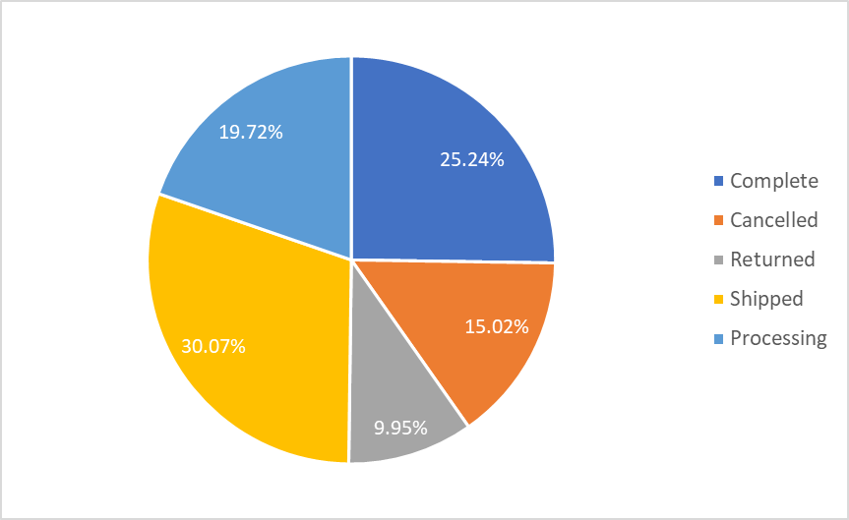
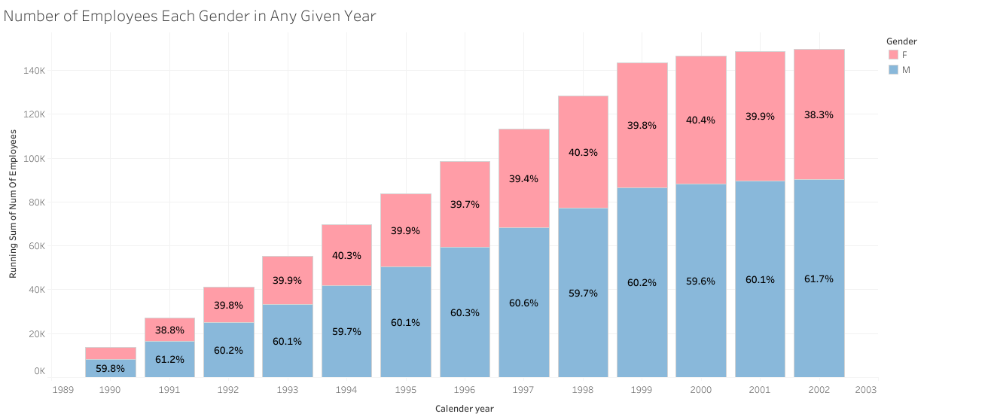
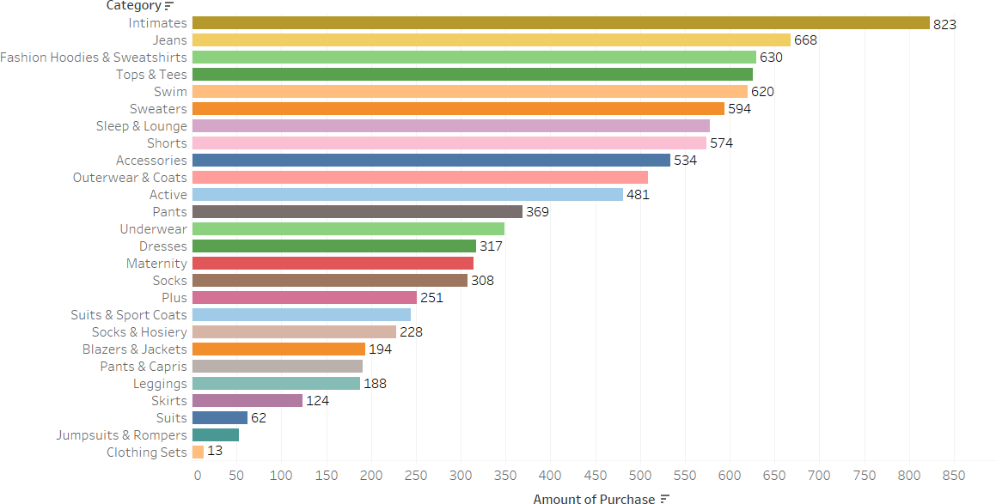
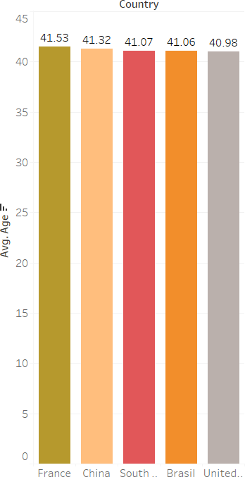
Employee Number
Purchase Status in 14 Countries
R E V O U D A T A A N A L Y T I C S C A S E S T U D Y
Best Selling Product Category in China
Average age of e-commerce user in top 5 country
5

Slide 4
R E S U LT
Average user age in top 5 largest e-commerce users country is France.
Therefore, there is no significant different between each country as the age gap is less than 1 year.
Intimates become the most sought after product category in China for the last 6 months.
While Clothing Sets become the least desirable product category in China For periode 26 February 2022 until 26 August 2022 :
30.07% of order already shipped
25.24% of order completed.
19.72 % of order is on process.
15.02% of order cancelled.
9.95% product returned.
R E V O U D A T A A N A L Y T I C S C A S E S T U D Y
6

